Slide 1

Advanced Computing Concepts
Submitted to:
Prof. Mahdi Firoozjaei
Web Search Engine
Jenil Patel - 110087778
Deep Patel - 110077739
Jay Shah - 110074737
Abhee Baboo Hudani - 110074796
Ghavan Patel - 110073456

Slide 2
Content
Introduction
Crawler
Html to Text
Word Suggestions
URL Finder
Page Ranking
Git Standards
DevOps: CI, GitHub Actions, Docker

Slide 3

Duties
Jenil Patel – Web Crawler
Deep Patel – HTML to Text
Jay Shah – Word Suggestion
Abhee Hudani – URL finder
Ghavan Patel – Page Ranking
Team Effort: DevOps

Slide 4

Introduction
Searching the web in systematic manner and efficiently
Designed to rank pages based on relevancy and popularity
Search engine depends on the Web Crawler, Indexing, Page Ranking, and many more underlying features
Popular search engines are Google, Bing, DuckDuckGo, etc.

Slide 5
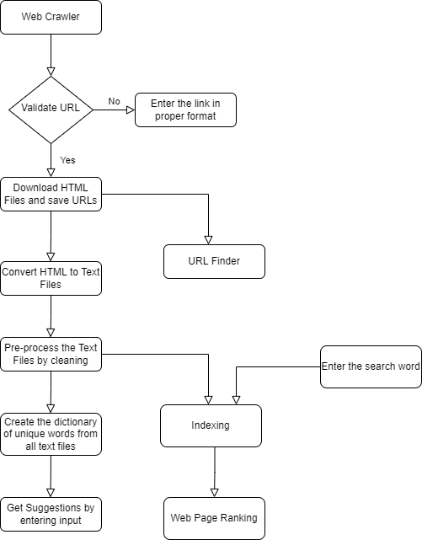
Flow Chart:

Slide 6


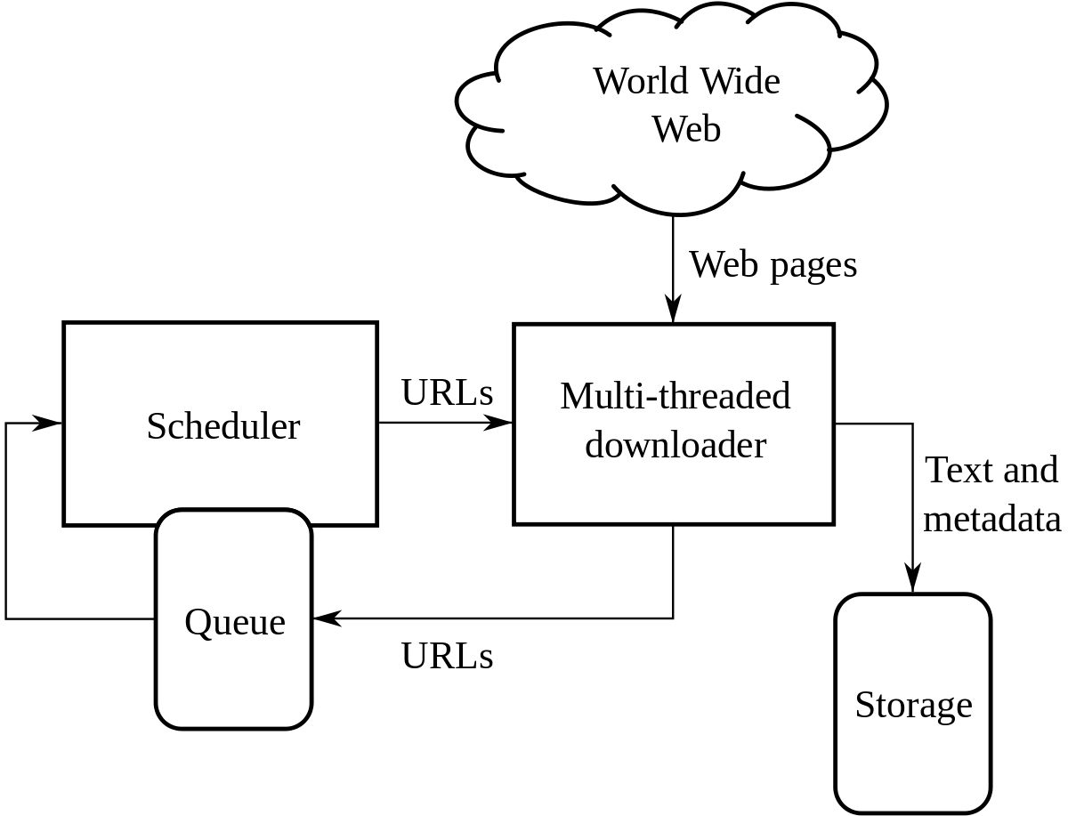
Crawler
Automated bot for crawling the web content
Starts with a seed usually a set of URLs
Stores all the hyperlinks of the visited URLs which is called crawl frontier
It stores the content of visited URLs
It should avoid the malicious websites and frequent crawling of a single website.

Slide 7

Behind the Crawler
Jsoup for parsing the HTML files from URL
Using DOM(Document object model) or CSS selectors to find and get specific data
Validating URLs
Checking the URL connection and response availability
Using Regex(Regular Expression) to match, get and replace particular pattern
HashSet is used to avoid duplication of URLs and ArrayList is used to maintain the crawl frontier

Slide 8


Html To Text
Basically, when all the HTML files are ready, they are therefore converted to text files by using the Jsoup library.
The text data which is present in HTML file is stored in the string format and thereby after using the Buffered Writer they are written in the text files.
A folder is created of converted text files which contains the text data of all the HTML files.
Now all the text files are converted to cleaned text files as all the stop-words are removed from it.

Slide 9


Word Suggestion
When all the text files are cleaned a dictionary of unique words is created. For obtaining the unique words HashSet is used.
A dictionary file is made by using the stemming concept which can be implemented by using Lucene library provided by Java.
When the user inputs the word, edit distance algorithm is applied and the nearest word is calculated based on it.
Finally, a list of all possible suggestions will be provided to the user.

Slide 10

URL Finder
The web crawler has created one file which contains all the links visited by crawler and also the hyperlinks from those web pages visited.
By using a regex pattern, we will filter out the invalid URLs and make sure that URLs are in proper format.
It will retrieve the URLs based on the user input.
Pattern and Matcher are classes are used to implement this feature.

Slide 11

Page Ranking
Page ranking looks for a word in each of the files and then sorts them in descending order depending on how often the word appears in the files.
Initially, two HashMaps are created : a) Index as key and value as a file name and b) Words as a key and values as set of filenames in which those words exist.
Then, searching will check for the word in the dictionary and if the word is not found then related suggestions will be given to the user and if the word is exactly found then search take place using HashMap to find all the files with a given search.
At last, webpage ranking algorithm uses the output files to sort them by frequency.
Sorting is done here using the Collections.sort() function which sorts using Mergesort.

Slide 12
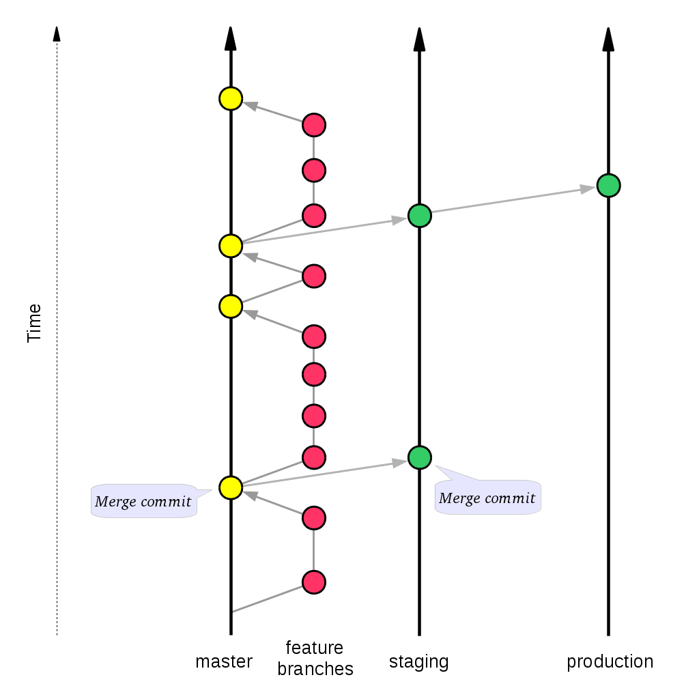

Git Standards
Main branch should be done via PR merge.
A reviewer is required in order to merge the PR.
A build pass success is required.
Branches:
Main
Feature
Fix
Enhancement
Test

Slide 13
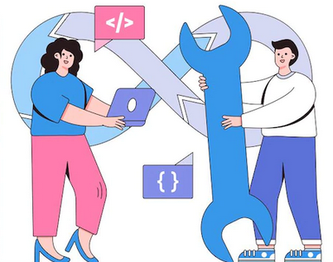
DevOps : CI
Continuous integration is a DevOps software development practice where developers regularly merge their code changes into a central repository, after which automated builds.
Release Build: https://github.com/Novartus/ACC-Final-Project/releases

Slide 14

Behind the working of CI
Create a custom build file according to project(Ant/ Maven)
Config the build commands
A CI/CD platform, that can fire these commands
An update to GitHub with the help of webhooks.

Slide 15

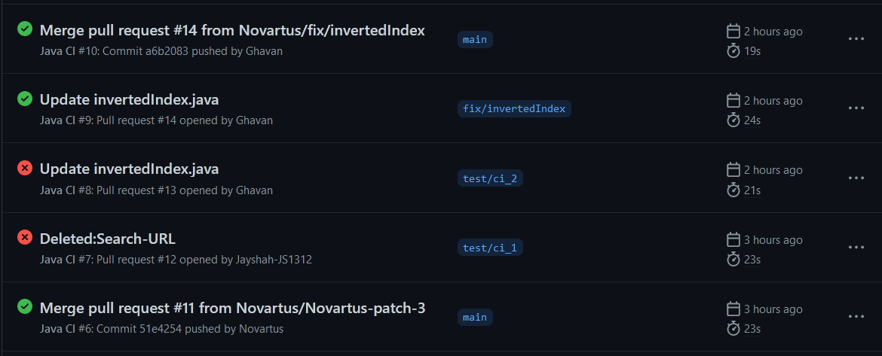
GitHub Actions
GitHub Actions is a continuous integration and continuous delivery (CI/CD) platform that allows us to automate your build, test, and deployment pipeline.
We can create workflows that build and test every pull request to your repository or deploy merged pull requests to production.
CI Build List
It will check whether build can be generated or not.
If it throws an error during the build, then Status will be marked as failure.
Email notification will be sent according to the same.

Slide 16


Continuous Integration Demo

Slide 17

Docker
Docker is a set of platform as a service (Paas) products that use OS-level virtualization to deliver software in packages called containers.
For this project we've dockerized the entire application.

Slide 18

Conclusion
Used Algorithms & Data Structure:
Edit Distance
Pattern Matching
Hash-Set, Hash-Map
Merge Sort
Future Scope:
Responsive UI for user experience
Expanding the searching capability
Future Scope for DevOps:
CI/CD Pipeline with Jenkins
Automatic Releases

Slide 19

References
https://www.deepcrawl.com/knowledge/technical-seo-library/how-do-search-engines-work/
https://www.searchenginejournal.com/search-engines/
https://developers.google.com/search/docs/beginner/seo-starter-guide
https://www.freepik.com

Slide 20

Thank You

